Slide 1
Stack
Dr. Eman Mounir
Eng. Gehad Mustafa
Eng. Eman Samy

Slide 2
What is a stack?
Stack is a data structure in which data is added and removed at only one end called the top.
To add (push) an item to the stack, it must be placed on the top of the stack.
To remove (pop) an item from the stack, it must be removed from the top of the stack too.
Thus, the last element that is pushed into the stack, is the first element to be popped out of the stack. i.e., Last In First Out (LIFO)

Slide 3
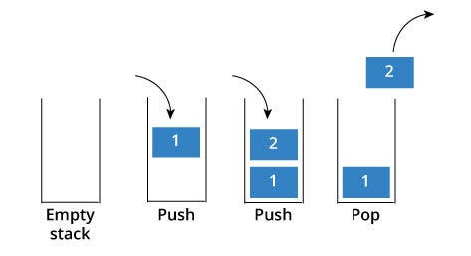
Stack

Slide 4
Stack Functions
The functions associated with stack are:
isEmpty(): true if the stack currently contains no elements
isFull(): true if the stack is full; only useful for static stacks
size(): Returns the size of the stack
top(): Returns a reference to the top most element of the stack
push(g): Adds the element ‘g’ at the top of the stack
pop() :Deletes the most recent entered element of the stack

Slide 5
Stack types
Static: fixed size, often implemented using an array.
Dynamic: size varies as needed, often implemented using a linked list

Slide 6
Static Stack
Uses an array of a fixed size
Bottom of stack is at index 0.
A variable called top tracks the current top of the stack
top is where the next item will be added

Slide 7
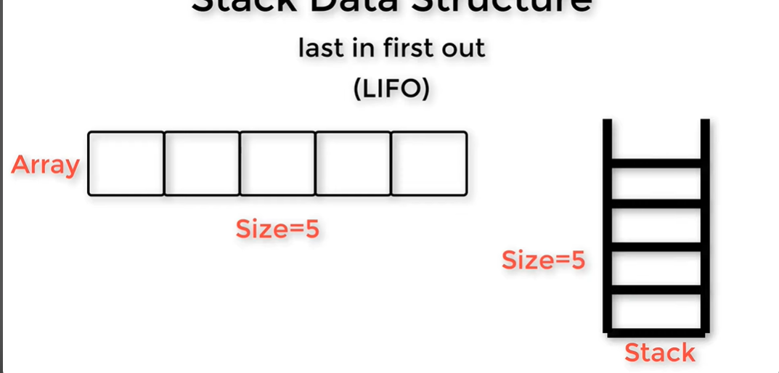
Static Stack

Slide 8
Stack implementation using array
Data_type_of_stack name_of_stack [Size_of_stack];
int top=-1
top is where the next item will be added

Slide 9
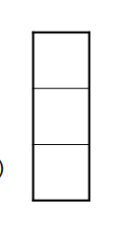
EX.
const int STACK_SIZE = 3;
char s[STACK_SIZE];
int top = 0;
S
Top=0

Slide 10
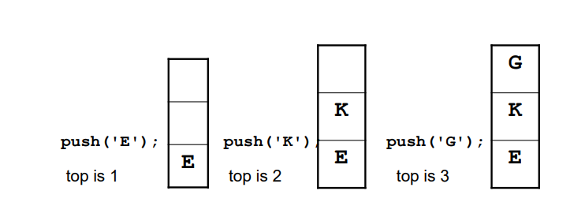
Implementation Example

Slide 11
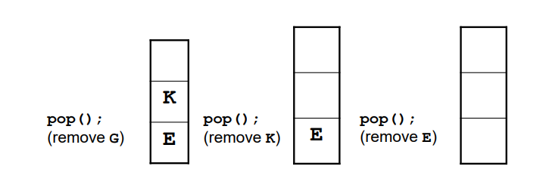

Slide 12
Try
To write the Static Stack Implementation from scratch “ using array”

Slide 13
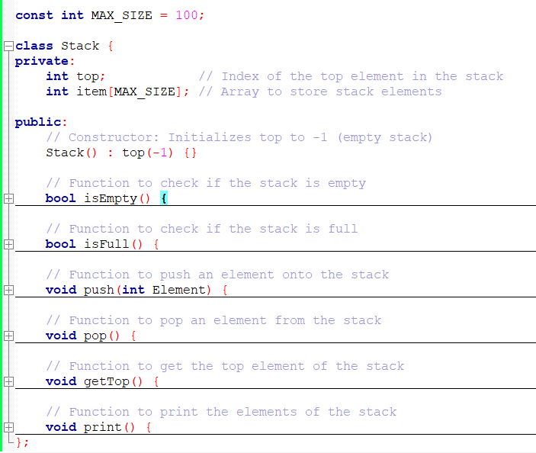
Class Implementation
private means that it can only used by the class internally and cannot be accessed outside of the said class, while public means that it can be accessed outside the class.

Slide 14
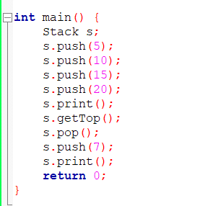
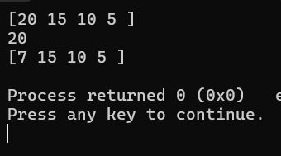
EX

Slide 15
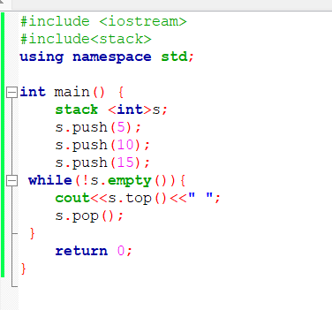
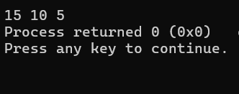
Ex.

Slide 16
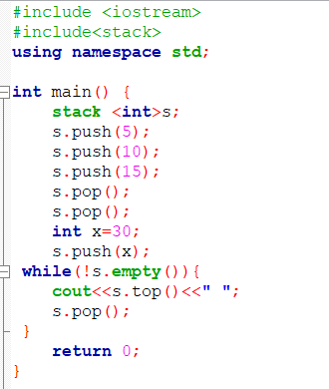
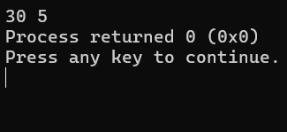
EX.

Slide 17
Dynamic Stacks
Implemented as a linked list
Can grow and shrink as necessary
Can't ever be full as long as memory is available

Slide 18
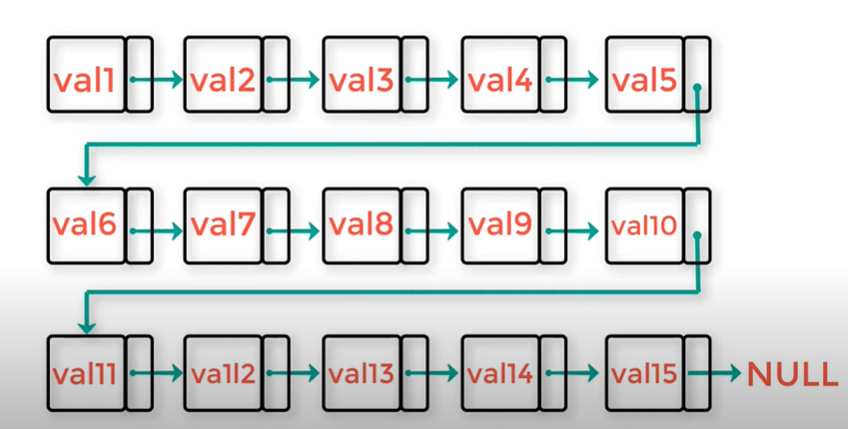
Dynamic Stacks
node

Slide 19
Node
p
p
Value
next
Value
pointer
pointer

Slide 20
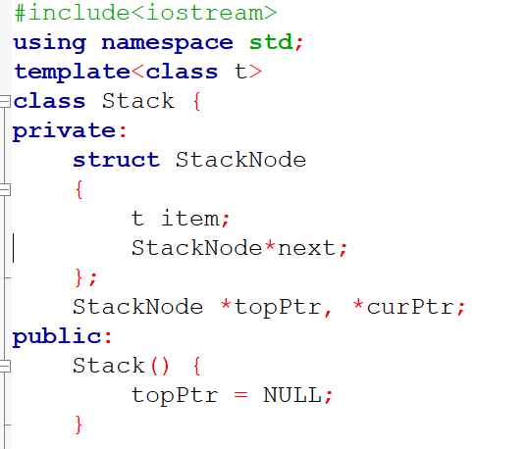
Linked stack

Slide 21
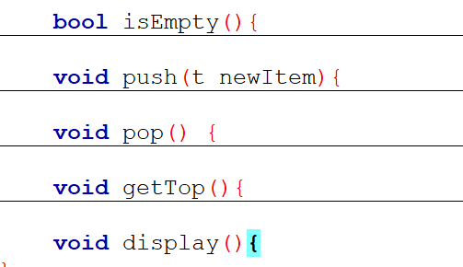
Linked stack

Slide 22
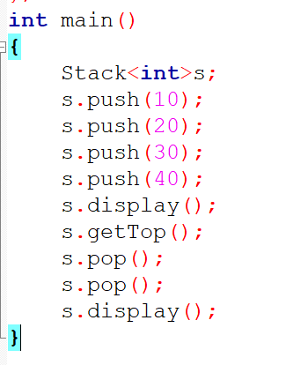
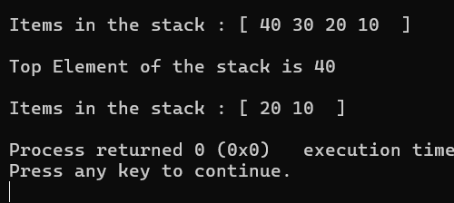
Ex.

